Slide 1
Chapter 4 Hybrid Evolutionary Algorithm: A Case Study on Graph Coloring
吕志鹏
教授，博士生导师
计算科学理论研究所 常务副所长
华中科技大学 计算机科学与技术学院
Part of this lecture has been given at the Dresden University of Technology in Germany

Slide 2
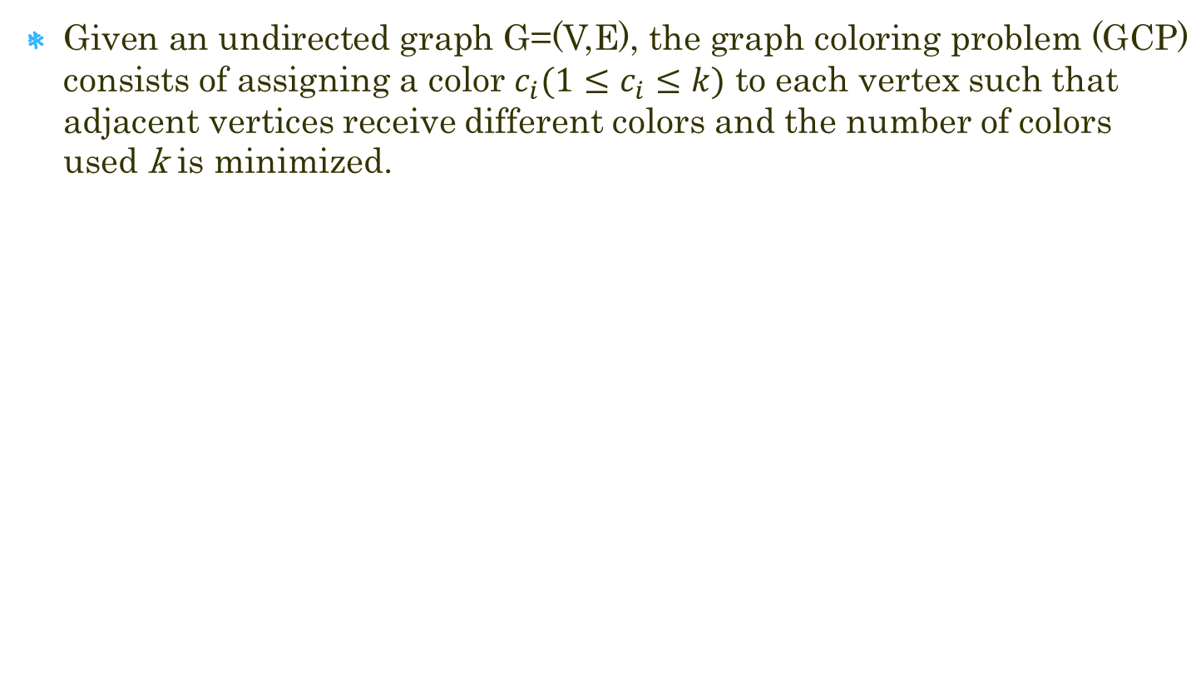
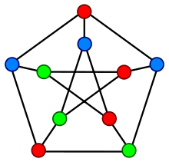
Graph Coloring

Slide 3
Optimization or Decision?
GCP—Optimization Problem (NP Hard):
  To find the smallest number of colors k.
k-Coloring—Decision Problem (NP Complete):
  Given a k, we are asked whether there exists a coloring such that all the adjacent coloring constraints are satisfied.
The Optimization version of GCP can be solved by tackling a series of the Decision version of GCP problem with a gradually decreasing k.
Thus, these two versions are equivalent to each other.

Slide 4
Solution Procedure
We starts from an initial k and solve the k-coloring problem. As soon as the k-coloring problem is solved, we decrease k by setting k to k-1 and solve again the k-coloring problem.
This process is repeated until no legal k-coloring can be found.
Smaller k → harder k-coloring problem. Thus, the solution approach just described solves thus a series of k-coloring problems of increasing difficulty.
We only consider the K-coloring problem in this presentation.

Slide 5
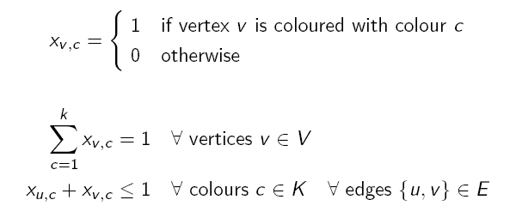
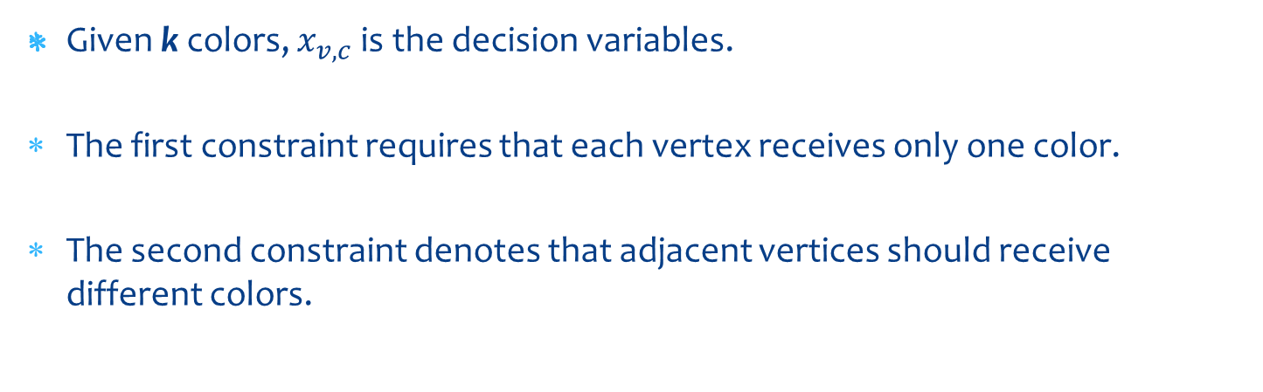
ILP Formulation

Slide 6
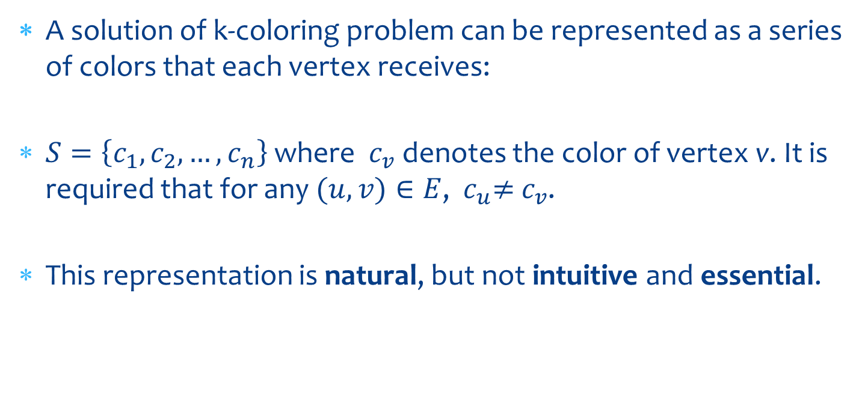
Assignment Representation

Slide 7
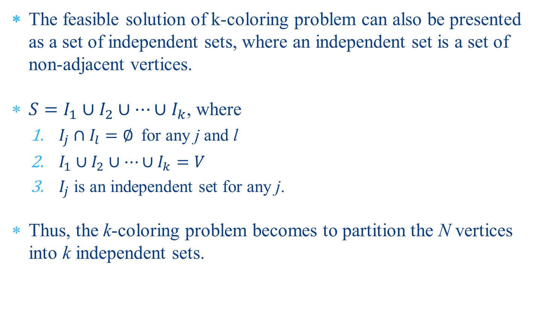
Grouping Representation

Slide 8
Applications
Mobile radio frequency assignment
Timetabling: Education, transportation, sports
Register allocation
Crew scheduling
Printed circuit testing
Air traffic flow management
Satellite range scheduling
Routing and wavelength assignment in WDM networks

Slide 9
Literature Review (1)
Constructive Greedy Algorithms
The first heuristic approaches to solving the graph coloring problem, which color the vertices of the graph one by one guided by a greedy function.
They are very fast by nature but their quality is unsatisfactory.
The best known algorithms in this class are:
  the largest saturation degree heuristic (DSATUR) (D. Brelaz, 1979)
  recursive largest first heuristic (RLF) (F.T. Leighton, 1979)
Often used to generate initial solutions for advanced algorithms

Slide 10
Literature Review (2)
Local Search Algorithms
One representative example is the so-called Tabucol algorithm which is the first application of Tabu Search to graph coloring (Hertz, de Werra, 1987)
Other local search metaheuristic methods include:
  Simulated Annealing (Johnson et al, 1991)
  Iterated Local Search (Chiarandini and Stutzle, 2002)
  Reactive Partial Tabu Search (Blochliger, Zufferey, 2008)
  GRASP (Laguna, Marti, 2001)
  Variable Neighborhood Search (Avanthay et al, 2003)
  Variable Space Search (Hertz et al, 2008)
  Clustering-Guided Tabu Search (Porumbel, Hao, 2009)
Interested readers are referred to [Galinier, Hertz, 2006] for a comprehensive survey of the local search approaches.
I will describe the famous Tabucol algorithm in detail.

Slide 11
Literature Review (3)
Hybrid Evolutionary Algorithms
One of the most recent and very promising approaches is based upon hybridization that embeds a local search algorithm into the framework of an evolutionary algorithm in order to achieve a better tradeoff between intensification and diversification, see for examples:
  Dorne, Hao, 1998
  Galinier, Hao, 1999
  Galinier, Hertz, Zufferey, 2008
  Malaguti, Monaci, Toth, 2008
  Porumbel, Hao, Kuntz, 2009

Slide 12
Initial Solution——DSATUR
The heuristic of DSATUR(Degree of Saturation) is to sequentially color vertices according to a DANGER-based heuristic. The main idea of DSATUR is based on least saturation degree.
At each phase, it consists of two steps: The first is to choose a vertex to color and the other is to choose a color for the chosen vertex.

Slide 13
Initial Solution——DSATUR
DSATUR starts by assigning color 1 to a vertex of maximal degree.
Suppose F is a partial coloring of the vertices of G. The degree of saturation of a vertex x, degs(x), is the number of available colors that vertex x can use.
The vertex to be colored next in the sequential coloring procedure of DSATUR is a vertex x with smallest degs(x), breaking ties by favoring vertex with larger uncolored degree.
When deciding a color for a chosen vertex the color that is least likely to be required by neighboring vertices is selected.

Slide 14
DSATUR
1. Initialization:
Color[N] = -1
Vetex_Color_Avail[N][K]=1
Num_Avail_Colors[N]=K
Vertex_Uncolored_Degree[N]=Degree[K]
Choose the vertex v1 with the largest degree, color v1 with color 1
Color[v1] = 1 ;
for v1’s adjacent vertices vj
Vetex_Color_Avail[vj][1] = 0 ;
Num_Avail_Colors[vj] -- ;
Vertex_Uncolored_Degree[vj] -- ;

Slide 15
DSATUR
for(i = 2 ; i <= N ; i ++)
  3.1 choose a vertex vi according to:
  < Num_Avail_Colors[vi] (small), Vertex_Uncolored_Degree[vi](large)>
  3.2 choose a color ki for vertex vi:
  for each available color j for vertex vi
  calculate the number of uncolored vertices for which color j is available
  choose color ki with the smallest value of this number
  3.3 color vertex vi with color ki and updating:
  Color[vi] = ki ;
for vi’s adjacent vertices vj
Vertex_Uncolored_Degree[vj] -- ;
if(Vetex_Color_Avail[vj][ki] == 1)
Num_Avail_Colors[vj] -- ;
Vetex_Color_Avail[vj][ki] = 0 ;

Slide 16
Improvements for DSATUR
It is possible to improve DSATUR heuristic by considering more sophisticated information.
For example, in case of choosing a color for the vertex, it would be better to consider the number of available colors.
What else heuristics can be inspired in choosing vertex and choosing color?

Slide 17
Local Search
TabuCol

Slide 18
Search Space
In this paper, we adapt the k-fixed penalty strategy which is also used by many coloring algorithms.
For a given graph G = (V; E), the number k of colors is fixed and the search space contains all possible (legal and illegal) k-colorings.
A k-coloring is represented by S = {V1, …,Vk} such that Vi is the set of vertices receiving color i.
Thus, if for all Vi are independent sets, then S is a legal k-coloring. Otherwise, S is an illegal (or conflicting) k-coloring.

Slide 19
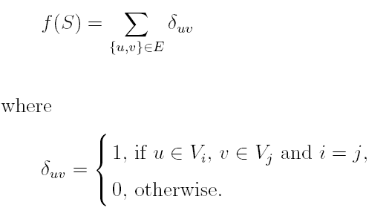
Evaluation Function
The optimization objective is then to minimize the number of conflicting edges (referred to confict number hereafter) and find a legal k-coloring in the search space.
Given a k-coloring S = {V1,…,Vk}, the evaluation function f counts the conflict number induced by S such that

Slide 20
Initial Coloring
The initial solution of our algorithm is randomly generated, i.e., each vertex in the graph is randomly assigned a color from 1 to k.
Other greedy constructive heuristics are possible, like DSATUR, RLF, DANGER, etc.
However, we observe that strong local search algorithms are not sensitive to the initial solutions.

Slide 21
Neighborhood Moves
A neighborhood of a given k-coloring is obtained by moving a conflicting vertex u from its original color class Vi to another color class Vj (denoted by <u, i, j>), called “critical one-move” neighborhood.
Therefore, for a k-coloring S with cost f(S), the size of this neighborhood is bounded by O(f(S) × k).

Slide 22
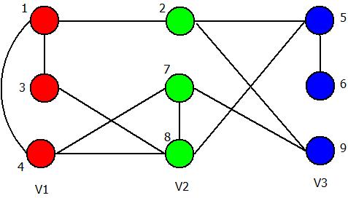
An Example
f = 4
Conflicting pairs: (1,3), (1,4), (7,8), (5,6)
Critical One-Move: Only considers vertices 1, 3, 4, 7, 8, 5, 6. Totally 7*2=14 moves.

Slide 23
Neighborhood Evaluation
In order to evaluate the neighborhood efficiently, we employ an incremental evaluation technique.
The effect of each move on the objective function can be quickly calculated by a special data structure.
Each time a move is carried out, only the move values affected by this move are updated accordingly.

Slide 24
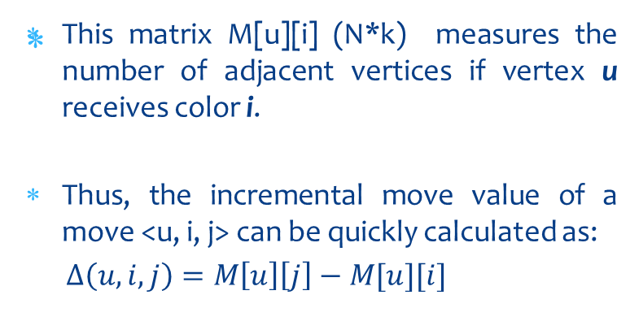
Adjacent-Color Table
Vertex | Red V1 | Green V2 | Blue V3
1 | 2 | 1 | 0
2 | 1 | 0 | 1
3 | 1 | 1 | 0
4 | 1 | 2 | 0
5 | 0 | 2 | 1
6 | 0 | 0 | 1
7 | 1 | 1 | 1
8 | 2 | 1 | 1
9 | 0 | 2 | 0

Slide 25
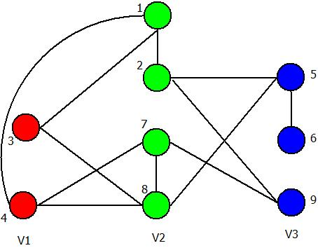
Updating of Adjacent-Color Table
Vertex | Red V1 | Green V2 | Blue V3
1 | 2 | 1 | 0
2 | 1-1=0 | 0+1=1 | 1
3 | 1-1=0 | 1+1=2 | 0
4 | 1-1=0 | 2+1=3 | 0
5 | 0 | 2 | 1
6 | 0 | 0 | 1
7 | 1 | 1 | 1
8 | 2 | 1 | 1
9 | 0 | 2 | 0
Move (1, v1, v2):
Only its adjacent vertices 2, 3 and 4 are affected, and only the v1 and v2 columns need to be updated.
All old color (v1) columns decrease by 1.
All new color (v2) columns increase by 1.

Slide 26
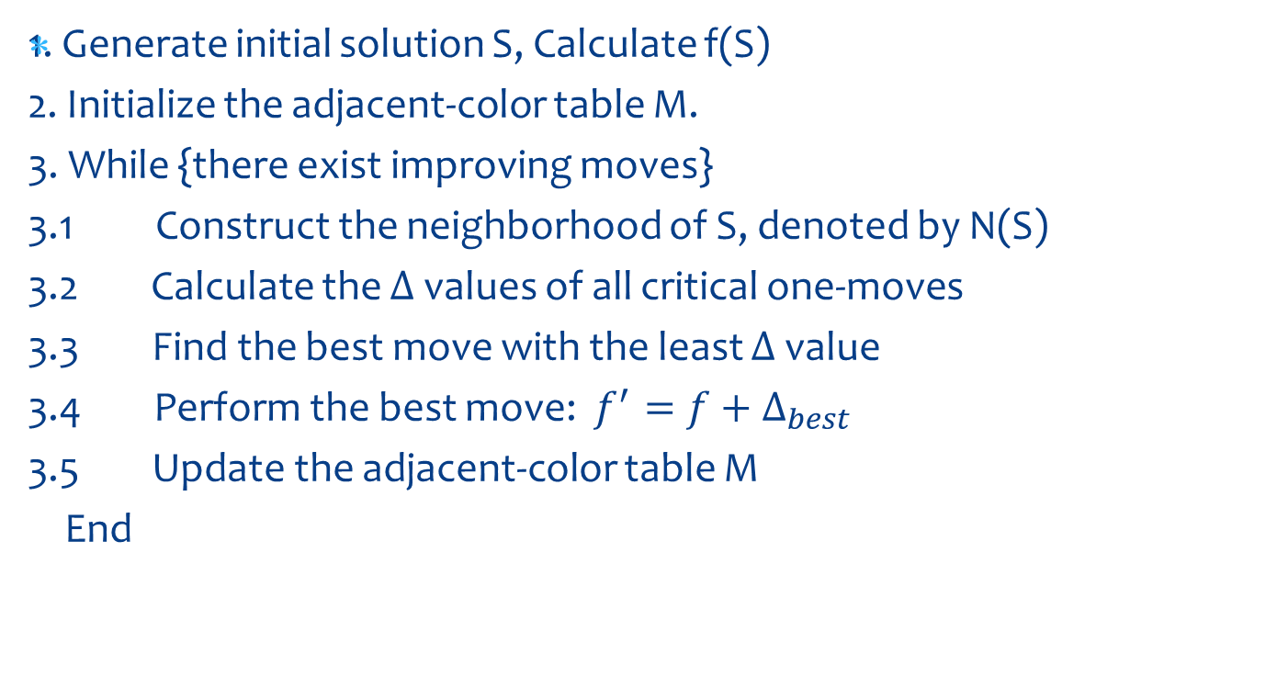
Simple Local Search

Slide 27
Tabu Search
Escaping from Local Optimum
Tabu Search incorporates a tabu list as a “recency-based” memory structure to assure that solutions visited within a certain span of iterations, called tabu tenure, will not be revisited.
TS then restricts consideration to moves not forbidden by the tabu list, and selects a move that produces the best move value to perform.

Slide 28
Tabu Search
1. What?
2. Tenure?
3. How to judge if a move is forbidden?

Slide 29
Attributes or Solution?
It should be noted that we generally forbid attributes of solutions, but not the solutions themselves, since it is too expensive to forbid solutions.
For the tabu list, once move <u, i, j> is performed, vertex u is forbidden to move back to color class Vi for the next tt iterations.

Slide 30
Tabu Tenure
For the tabu list, once move <u, i, j> is performed, vertex u is forbidden to move back to color class Vi for the next tt iterations.
Here, the tabu tenure tt is dynamically determined by
tt = f(S) + r(10)
where r(10) takes a random number in {1,…,10}.

Slide 31
TabuTenure Table
Vertex | Red V1 | Green V2 | Blue V3
1 | 9 | 0 | 0
2 | 0 | 10 | 0
3 | 0 | 0 | 0
4 | 0 | 0 | 0
5 | 0 | 0 | 0
6 | 0 | 0 | 0
7 | 0 | 0 | 0
8 | 0 | 0 | 0
9 | 0 | 0 | 0
At the begining of the search, the TabuTenure table is initialized to be zero.
once move <u, i, j> is performed, the value of Table[u][i]=TabuTenure.
Once the search progresses, the non-zero value of the table is decreased by one at each time.
In the following search, we can decide if a move <u, i, j> is tabu by checking if Table[u][j]>0.

Slide 32
Fast Implementation of TabuTenure Table
Vertex | Red V1 | Green V2 | Blue V3
1 | 1+10 | 0 | 0
2 | 0 | 2+15 | 0
3 | 0 | 0 | 0
4 | 0 | 0 | 3+12
5 | 0 | 0 | 0
6 | 0 | 0 | 0
7 | 0 | 4+10 | 0
8 | 0 | 0 | 0
9 | 0 | 0 | 5+12
The above Table[u][i] records the relative tabu tenure length. Why not record the absolute tabu tenure length?
Once move <u, i, j> is performed, the value of Table[u][i] = TabuTenure+Iter.
In the following search, we can decide if a move <u, i, j> is tabu by checking if Table[u][j]>Iter.
In this way, the tabu tenure table can be updated in O(1).

Slide 33
Aspiration
If one move can override the best found solution found so far, it is accepted even if it is in tabu status.
This is because only the attributes but not solutions themselves are stored in the tabu table.

Slide 34
Hybrid Evolutionary Algorithm

Slide 35
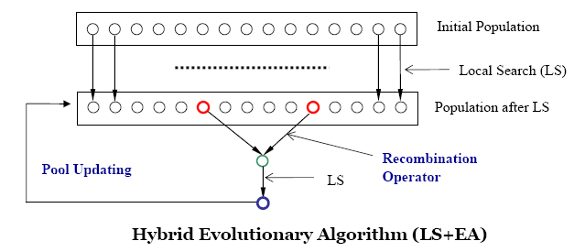
Main Scheme

Slide 36
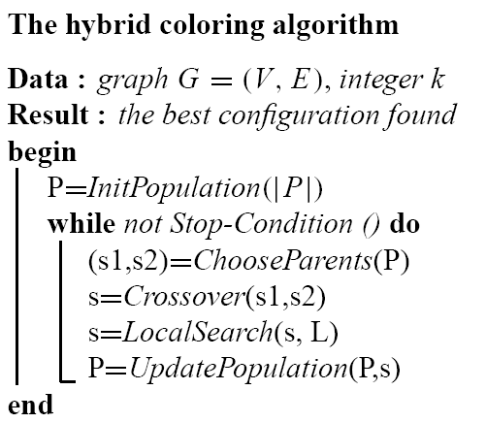
Hybrid Evolutionary Algorithm

Slide 37
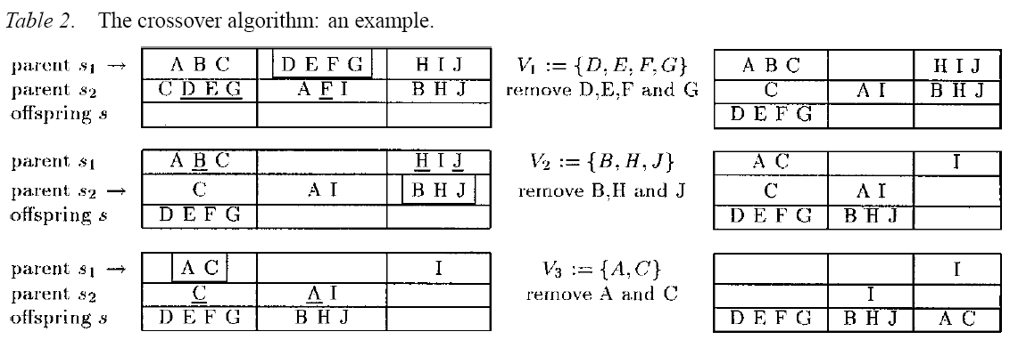
Crossover Operator (1)

Slide 38
Crossover Operator (2)
A legal k-coloring is a collection of k independent sets.
With this point of view, if we could maximize the size of the independent sets by a crossover operator as far as possible, it will in turn help to push those left vertices into independent sets.
In other words, the more vertices are transmitted from parent individuals to the offspring within k steps, the less vertices are left unassigned.
In this way, the obtained offspring individual has more possibility to become a legal coloring.

Slide 39
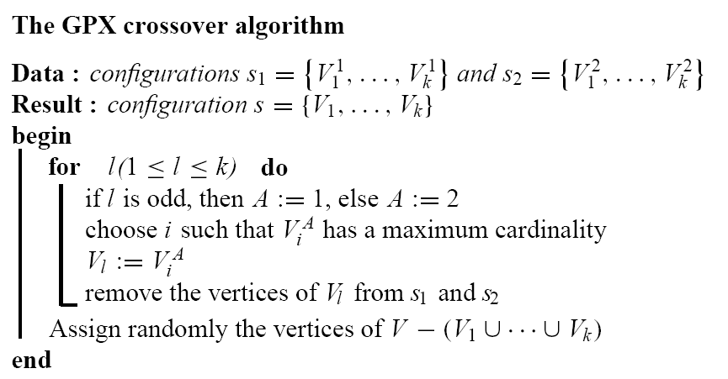
Crossover Operator (3)

Slide 40
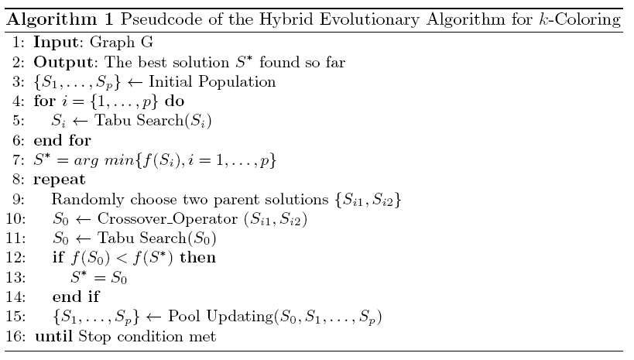
HEA Algorithm Scheme

Slide 41
Thank You!

